Slide 1



Credit Card Fraud Detection
Final Year Presentation under the Supervision of
Dr. Richik Kashyap & Prof. Nirupam Shome
Department Of Electronics And Communication Engineering Assam University, Silchar
Presented by:
Devran Dey Sarkar (1181700008)

Slide 2

Table of Contents
About Credit Card Frauds | 3
Problem Statement | 4
Objective | 5
Dataset | 6
Process Block Diagram | 7
Existing Model | 8
Modified Model | 9
Modified Model Analysis | 10
Conclusion | 11
Future Goals | 12
References | 13

Slide 3

About Credit Card Frauds
What is it?
An unauthorized use of a Credit Card to fraudulently obtain money or property.
Where does it happen?
Credit card numbers can be stolen from unsecured websites or can be obtained in an identity theft scheme.
When does it happen?
When someone physically steals your card or virtually hacks your account.
Why does it happen?
“Remembering card number” on unsecure websites.
Shopping online on fraudulent websites.
Lost or stolen cards are not reported immediately, etc.
How does it happen?
Key-Stroke logging (malicious app).
Data breach from an organization’s database.

Slide 4
Motivation for work
There are lots of advantages associated with Credit Cards:
Ease of purchase
Keep customer credit history
Protection of purchases
But due to the problem of fraud in Credit Cards, people and banking institutions suffer huge losses every year.
Our motivation for work is to provide a safer environment for credit card transactions.

Slide 5
Applications of Credit Card fraud detection model
Individuals, Banks and financial institutions are very susceptible to this threat.
Utilisation of these models can help reduce Credit Card Fraud issues in online transactions.

Slide 6
Challenges and Issues
Very limited dataset is provided regarding this issue
Banks cannot disclose the transactions details, so features of the transactions are not provided. Therefore, testing of the model is not possible in real life circumstances without banks or dataset providers’ help.
Highly imbalanced dataset, so massive data pre-processing is required.

Slide 7
Problem Statement
Credit Card Fraud is a growing issue in today’s world of online transaction. Previously, many models and papers were proposed regarding this.
We intend to modify the pre-existing models [], [], [] suggested by the State of Art Literature.
Our aim is to fix the short comings of the pre-existing models and increase the robustness of the model.

Slide 8
Existing models in Deep Learning
On a detailed analysis of many research papers on Credit Card Fraud Detection, we came across three most updated research papers in which Deep Learning is implemented to solve this issue.
Existing Model-1: By Suresh Kumar and Asha RB
Existing Model-2: By Saurbh Dubey, Ketan Mundhe and Aditya AK
Existing Model-3: By Khalid, Ahmad, Mothanna and Omar

Slide 9
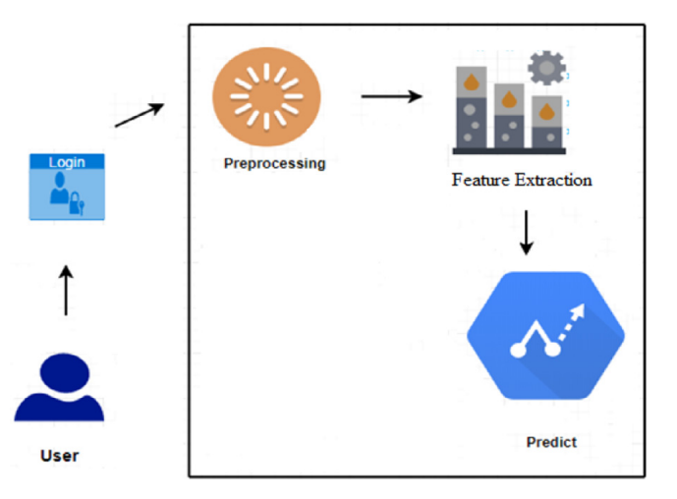
Existing model-1: By Suresh Kumar and Asha RB
Existing Model-1: By Suresh Kumar and Asha RB
Existing Model-2: By Saurbh Dubey, Ketan Mundhe and Aditya AK
Existing Model-3: By Khalid, Ahmad, Mothanna and Omar
This model utilises Artificial Neural Network (ANN) for classification.
The neural network consists of 5 hidden layer and the activation function used is RELU.
Fig- Complete Architecture of the proposed system

Slide 10
Results of Existing Model-1
Existing Model-1: By Suresh Kumar and Asha RB
Existing Model-2: By Saurbh Dubey, Ketan Mundhe and Aditya AK
Existing Model-3: By Khalid, Ahmad, Mothanna and Omar
The accuracy achieved is close to 100%,
but the other results are not as impressive, and can be claimed as ‘poor’.
Accuracy | Precision | Recall | F1_Score
99.92 | 81.15 | 76.19 | 78.59

Slide 11
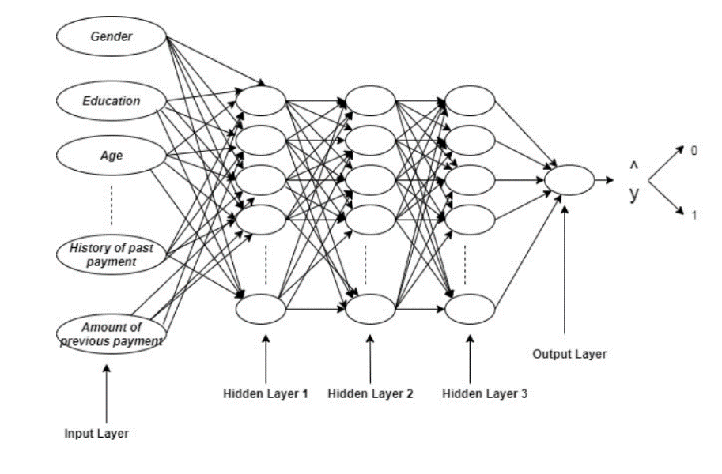
Existing model-2: By Saurbh D., Ketan Mundhe and Aditya AK
Existing Model-1: By Suresh Kumar and Asha RB
Existing Model-2: By Saurbh Dubey, Ketan Mundhe and Aditya AK
Existing Model-3: By Khalid, Ahmad, Mothanna and Omar
The proposed system uses Artificial Neural Networks and Backpropagation to find fraudulent transactions.
Here, 3 hidden layers are used.
For the Hidden Layers, RELU activation function is used. At the Output Layer, Sigmoid activation function is used.
Fig- Architecture of ANN

Slide 12
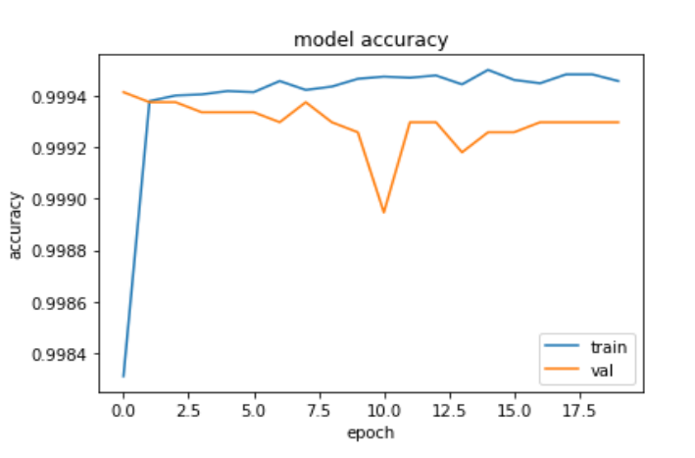
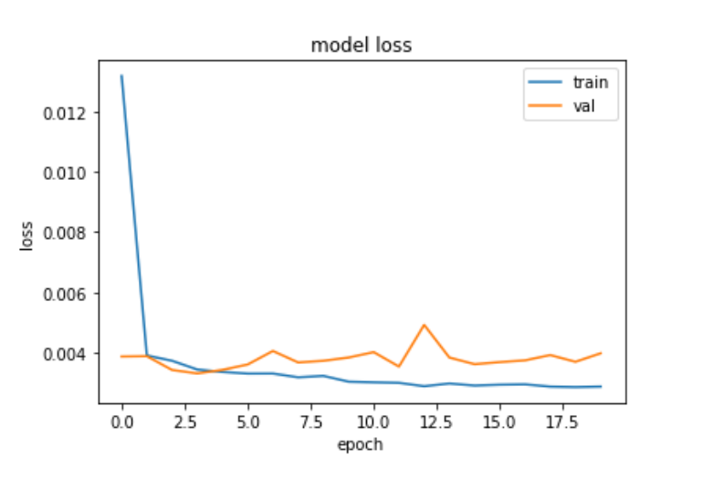
Results of Existing Model-2
Existing Model-1: By Suresh Kumar and Asha RB
Existing Model-2: By Saurbh Dubey, Ketan Mundhe and Aditya AK
Existing Model-3: By Khalid, Ahmad, Mothanna and Omar
The test dataset has 10% data (a total of 28481 transactions). This dataset is used for finding the various result parameters.
Accuracy | Precision | Recall | F1_Score
99.92 | 99.96 | 99.96 | 99.96
Fig - Model Accuracy of Train v/s Validate
Fig - Model Loss of Train v/s Validate

Slide 13
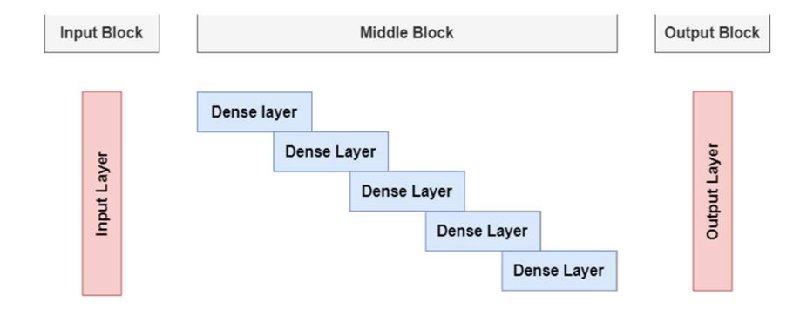
Existing model-3: By By Khalid, Ahmad, Mothanna and Omar
Existing Model-1: By Suresh Kumar and Asha RB
Existing Model-2: By Saurbh Dubey, Ketan Mundhe and Aditya AK
Existing Model-3: By Khalid, Ahmad, Mothanna and Omar
This model utilises Deep Neural Network (DNN) for classification.
The architecture of the model consists of 7 dense layers that are connected sequentially with 1024, 512, 256, 128, 64, and 32 neurons, where the Final Layer gets activated with Sigmoid Activation Function.
Fig- Complete Architecture of Deep neural Network classifier

Slide 14
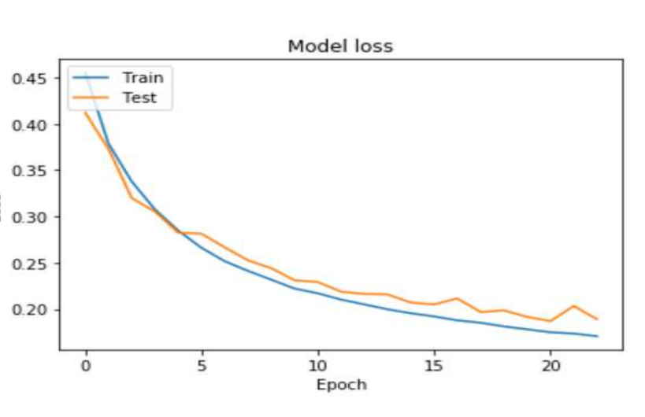
Results of Existing Model-3
Existing Model-1: By Suresh Kumar and Asha RB
Existing Model-2: By Saurbh Dubey, Ketan Mundhe and Aditya AK
Existing Model-3: By Khalid, Ahmad, Mothanna and Omar
As shown in the table, the classifier has achieved 95.3% score of Accuracy. Moreover, the results of precision and recall show that the classifier was able to identify 95.5% of the fraud transactions,
and it was able to predict 95.2% of the fraud transactions correctly form testing set.
Accuracy | Precision | Recall | F1_Score
0.953 | 95.5 | 95.2 | 95.4
Fig- The loss rate of Deep network classifier

Slide 15
Issues observed in existing models
Existing Model-1: By Suresh Kumar and Asha RB
The dataset is directly utilised for training the model. Leading to high accuracy value but low other result parameters.
Existing Model-2: By Saurbh Dubey, Ketan Mundhe and Aditya AK
The dataset is also not balanced before training. All the result parameters obtained from the paper are very good (nearing to 100%). But from the loss curve and accuracy curve, it can be observed that model is overfitted which must be avoided for developing a good model.
Existing Model-3: By Khalid, Ahmad, Mothanna and Omar
The dataset is properly pre-processed and the model shows very little sign of overfitting (observed in loss curve). But all the result parameters are around 95% only which is less compared to other research paper suggested models.

Slide 16
Dataset Pre-processing
Original Dataset (234807,31)
Legal (0) rows = 284315
Fraud (1) rows = 492
The dataset consists of 2,84,807 rows of credit card data. The dataset is highly imbalanced where the ratio between fraud and legitimate transactions is 0.001727.
Testing Data:
Fraud (1) = 49 = pasted 571times= 28126
Legal (0) =28481 = (kept as same) = 28481
Remaining Data
Fraud (1) = 443 = pasted 550 times= 243650
Legal (0) = 255834 = kept as same
Training Dataset 75%
Final count = 374613
Validation dataset 25%
Final count = 124871
Fig: Block Diagram of dataset pre-processing with values

Slide 17
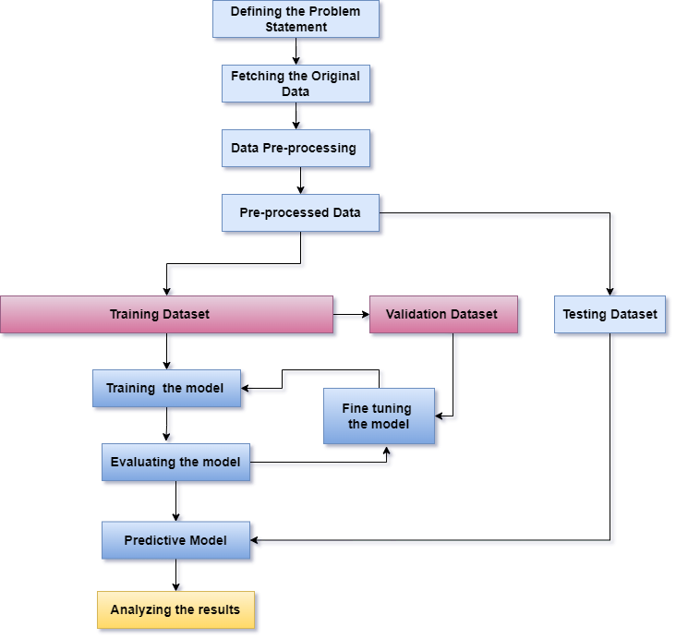
Block Diagram of Proposed Models

Slide 18
Proposed Models
Taking into consideration the issues and drawbacks observed in the existing models, we are proposing 4 models for Credit Card fraud detection using DNN as a classifier.
The datasets which we have used in this study have 4,99,484 rows of training and validation, and 56,607 rows of data for testing purpose.
The proposed models are compared with the existing models based on parameters like Accuracy, Precision, Recall, F1 score and MCC.
Learning Curves of the models are also built, in order to detect any kind of overfitting or underfitting of the model.

Slide 19
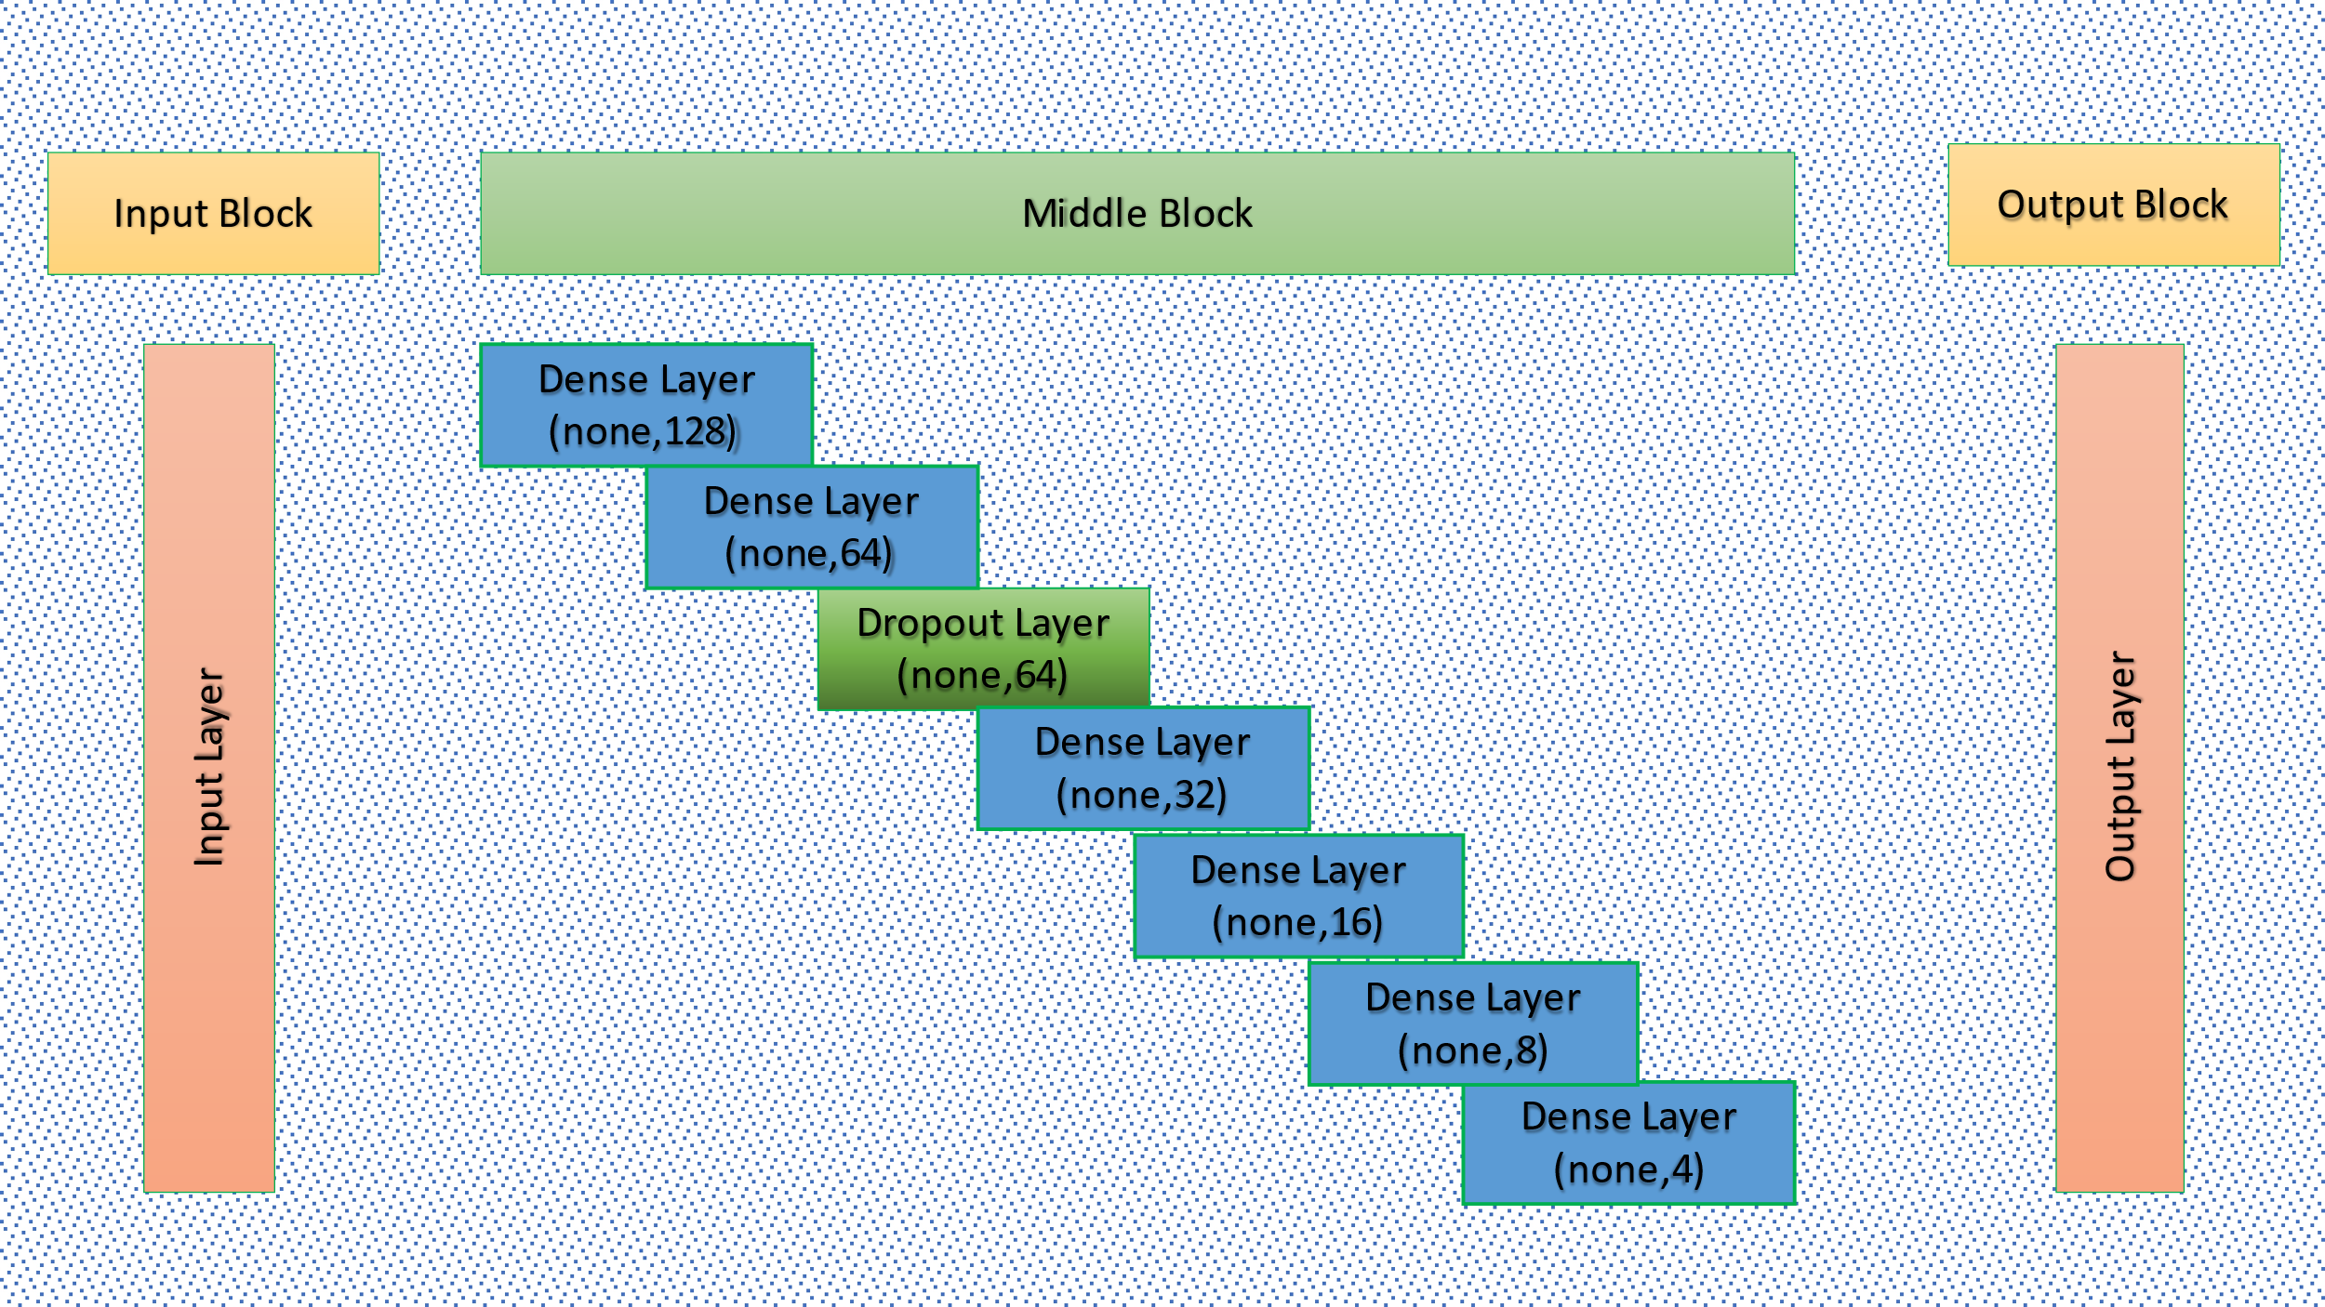
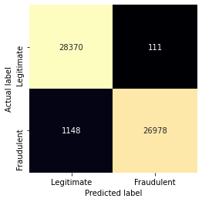
Proposed Model-1
The model consists of 6 hidden layers and one dropout layer.
Early stopping technique is used to stop the model to get overfit with training data.
Fig- Confusion Matrix of the model
Fig- Architecture of Proposed Model-1

Slide 20
Proposed Model-1
The model consists of 6 hidden layers and one dropout layer.
Early stopping technique is used to stop the model to get overfit with training data.
Fig- Confusion Matrix of the model

Slide 21
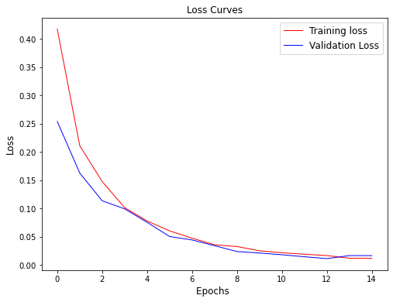
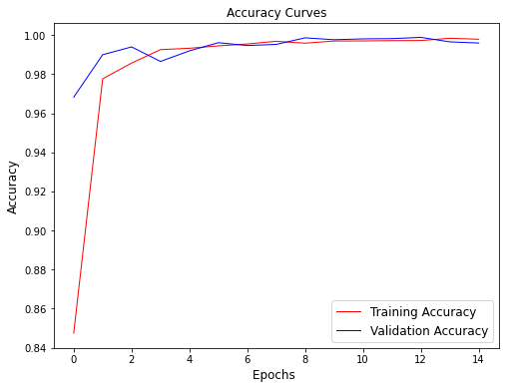
Results of Proposed Model-1
Accuracy | Precision | Recall | F1 Score | MCC
97.77589 | 99.5902 | 95.9183 | 97.7198 | 95.61482
Fig- Loss Curve of the model
Fig-Accuracy curve of the model

Slide 22
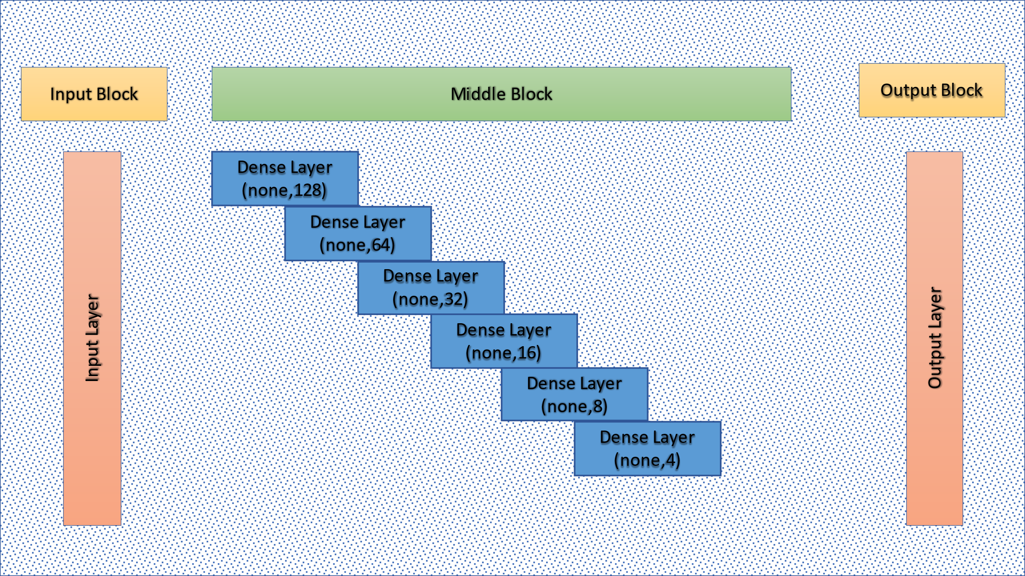

Proposed Model-2
The model consists of 6 hidden layers and without any dropout layer.
Early stopping technique is used to stop the model to get overfit with training data.
Fig- Confusion Matrix of the model
Fig- Architecture of Proposed Model-2

Slide 23
Proposed Model-2
The model consists of 6 hidden layers only and without any dropout layer.
Early stopping technique is used to stop the model to get overfit with training data.
Fig- Confusion Matrix of the model

Slide 24
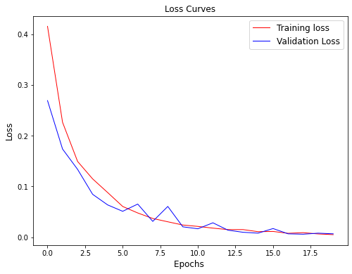
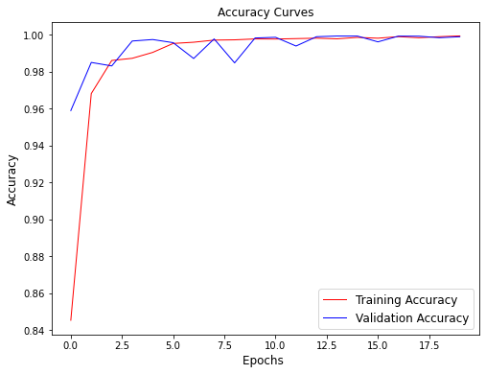
Results of Proposed Model-2
Accuracy | Precision | Recall | F1 Score | MCC
97.790025 | 99.6049 | 95.9183 | 97.73398 | 95.6441
Fig- Loss Curve of the model
Fig-Accuracy curve of the model

Slide 25
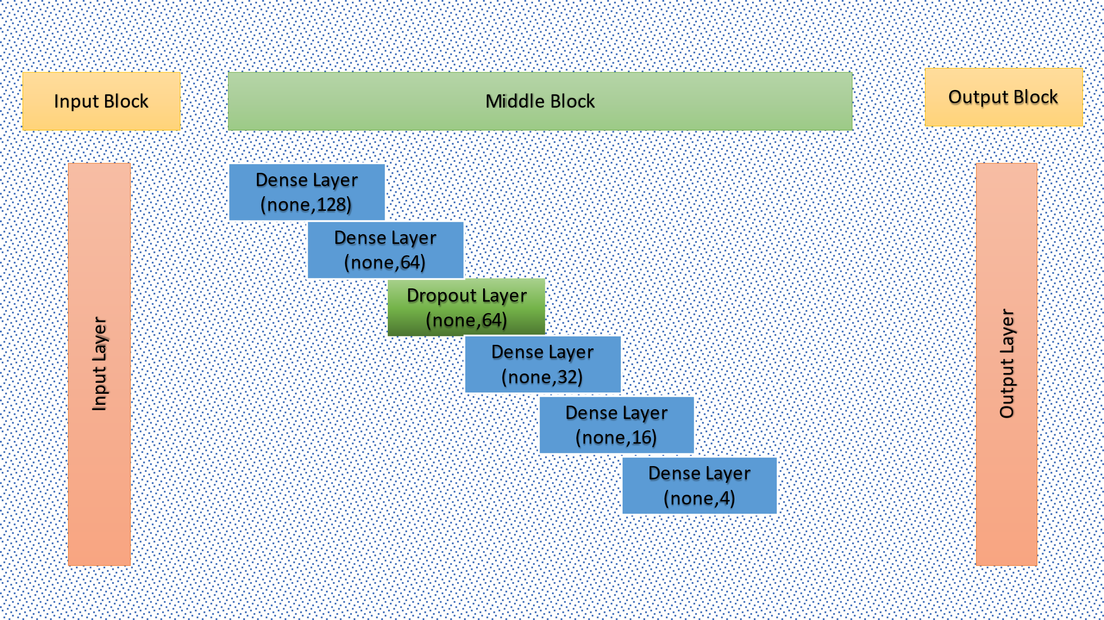
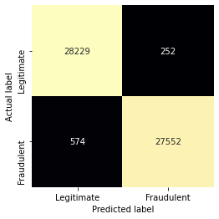
Proposed Model-3
The model consists of 5 hidden layers and 1 dropout layer.
Early stopping technique is used to stop the model to get overfit with training data.
Fig: Confusion matrix of the model
Fig- Architecture of Proposed Model-3

Slide 26
Proposed Model-3
The model consists of 5 hidden layers and 1 dropout layer.
Early stopping technique is used to stop the model to get overfit with training data.
Fig: Confusion matrix of the model

Slide 27
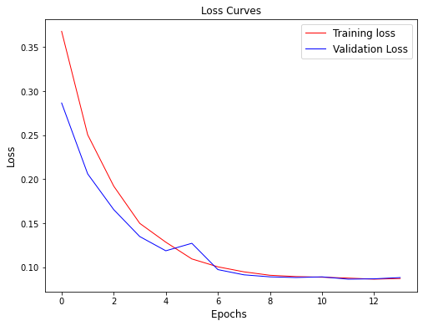
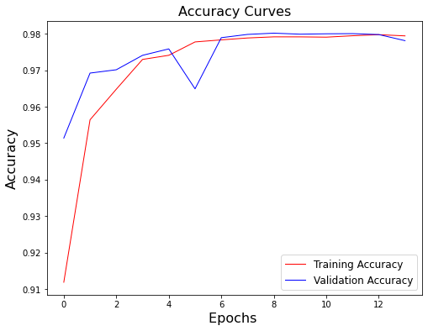
Results of Proposed Model-3
Accuracy | Precision | Recall | F1 Score | MCC
98.5408 | 99.09365 | 97.9591 | 98.52315 | 97.08759
Fig- Loss Curve of the model
Fig-Accuracy curve of the model

Slide 28
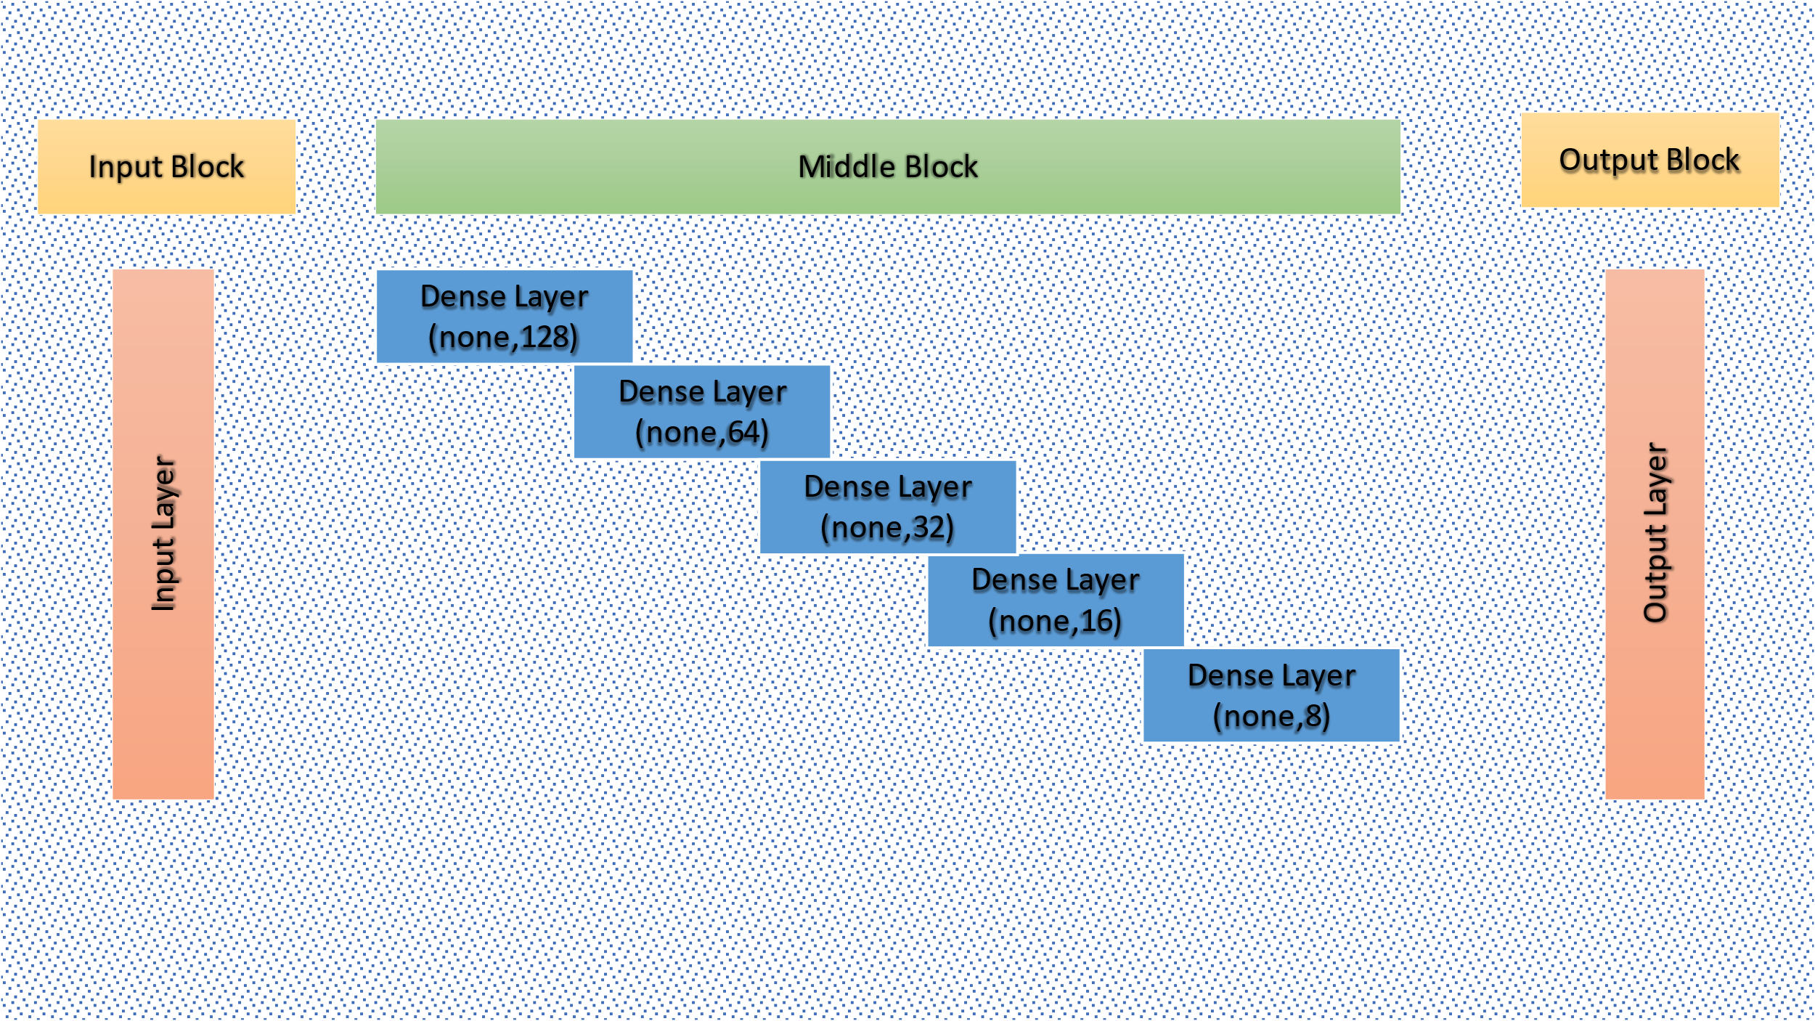
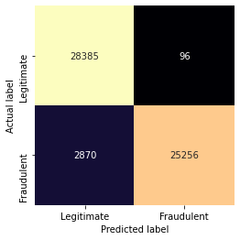
Proposed Model-4
The model consists of 5 hidden layers.
Early stopping technique is used to stop the model to get overfit with training data.
Fig- Confusion matrix of the model
Fig- Architecture of Proposed Model-4

Slide 29
Proposed Model-4
The model consists of 5 hidden layers.
Early stopping technique is used to stop the model to get overfit with training data.
Fig- Confusion matrix of the model

Slide 30
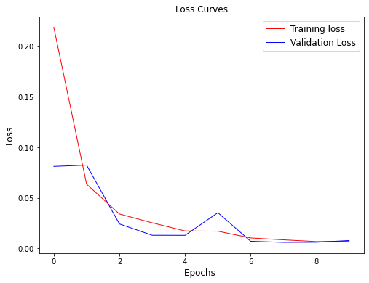
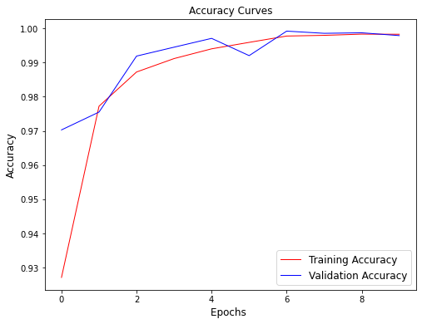
Results of Proposed Model-4
Accuracy | Precision | Recall | F1 Score | MCC
94.7603 | 99.6213 | 89.79591 | 94.4537 | 89.94749
Fig- Loss Curve of the model
Fig-Accuracy curve of the model

Slide 31
Existing Models Vs Proposed Models Analysis
Models | Accuracy | Precision | Recall | F1 Score | MCC | Remarks
State of Art Literature:
Suresh Kumar and Asha RB (2021)[] | 99.23 | 81.15 | 76.19 | 78.59 | 80.255 | Direct usage of highly unbalanced dataset leads to high accuracy.
Saurabh Dubey, Ketan Mundhe & Aditya AK (2020) [] | 99.2 | 99.96 | 99.96 | 99.96 | 81.46 | No data pre-processing is done; directly using the imbalanced data leading to model overfitting (model will always consider every transaction as legitimate). Model is overfitted can be predicted from the curve provided. Only 10% of the dataset is taken for testing purpose.
Khalid, Ahmad, Mothanna & Omar (2021) [] | 95.3 | 95.2 | 95.55 | 95.55 | - | The dataset is divided into (70%) Training and (30%) Testing data, both are used for training and validating the model. The testing data is again used for evaluating the model.
Proposed Model:
Model-1 | 97.77589 | 99.5902 | 95.9183 | 97.7198 | 95.61482 | In the proposed models, the dataset is pre-processed and balanced before training the model. Early stopping during training process and one dropout layer is introduced between hidden layers to stop overfitting or underfitting the model. The number of neurons is optimised in the hidden layers for better performance.
Model-2 | 97.790025 | 99.6049 | 95.9183 | 97.73398 | 95.6441
Model-3 | 98.5408 | 99.09365 | 97.9591 | 98.52315 | 97.08759
Model-4 | 94.7603 | 99.6213 | 89.79591 | 94.4537 | 89.94749
…

Slide 32
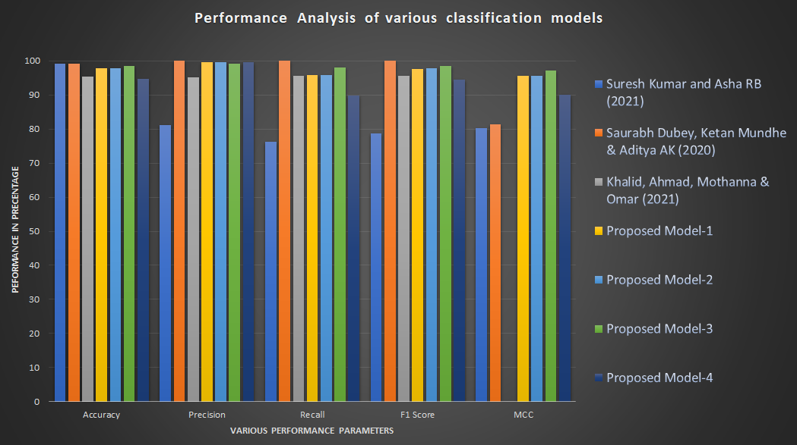
Existing model Vs Proposed Model Graphical Analysis
Fig- Graphical representation of the performance of all the models

Slide 33
Conclusion
The result parameters of the proposed models are almost same compared to the existing models. But getting out performed in terms of accuracy.
The MCC values of the proposed models are much higher compared to the existing models, MCC score of +100 % (or +1) is a prefect model.
The learning curves of the proposed models are much smooth compared to existing models, indicating overfitting is not present in the proposed models.

Slide 34
Future Goals
To improve the accuracy of the proposed models, by maintaining the values of the other parameters.
Data Augmentation: To increase the robustness of the models in fraud detection.

Slide 35
Reference
…

